Slide 1
C1.3 – Algorithms and programs – part 5
Topic | Content
Introduction | The term algorithm and common methods of defining algorithms; pseudocode, flowcharts and structured English.
C1.3.1 Variables and constants | The use of constants and variables in algorithms and programs
C1.3.2 Identifiers | The importance of using of self-documenting identifiers, annotation and program layout in programs. Examples of self-documenting identifiers, annotation and appropriate program layout.
C1.3.3 Scope of variables | The scope and lifetime of variables in algorithms and programs
C1.3.4 Parameters | The purpose and effect of procedure calling, parameter passing and return, call by reference and call by value.

Slide 2
C1.3 – Algorithms and programs – part 5
Topic | Content
C1.3.5 Mathematical operations | Mathematical operations in algorithms, including DIV and MOD
C1.3.6 Sorting | the characteristics of sorting algorithms: bubble sort and insertion sort.
C1.3.7 Searching | Using linear search algorithm and binary search algorithm. Follow search and sort algorithms and programs; make alterations to such algorithms and write search algorithms and programs.
C1.3.8 Problem analysis | Analyse a problem using appropriate design approaches.
C1.3.9 Programming constructs | Use sequence, selection and repetition in algorithms and programs. Use counts and rogue values in algorithms and programs

Slide 3
C1.3 – Algorithms and programs – part 5
Topic | Content
C1.3.10 Modular programming | The use of standard functions, standard modules and user defined subprograms
C1.3.11 Logical operations in algorithms and programs | Logical operators AND, OR, NOT and XOR in algorithms and programs.
C1.3.12 Compression | Data compression and how data compression algorithms are used.
C1.3.13 Testing | Test data to dry-run a program or algorithm in order to identify possible errors. Show the effects of test data.

Slide 4
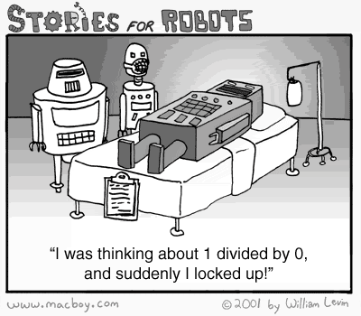
C1.3.12 Compression C1.3.13 Testing

Slide 5
Introduction to Data Compression
Compression algorithms work differently for different types of data.
There are also differences between lossy and lossless types of data.
Computer storage space and network bandwidth are both limited.
If the amount of file bytes can be reduced by removing unnecessary bits of data, more storage space is available and faster transmission speeds are achieved.

Slide 6
Compression
To reduce amount of storage required
lossless
recover exact text or image – e.g. GIF, ZIP
look for commonalities:
text: AAAAAAAAAABBBBBCCCCCCCC -> 10A5B8C
video: compare successive frames and store change
lossy
recover something like original – e.g. JPEG, MP3
exploit perception
JPEG: lose rapid changes and some colour
MP3: reduce accuracy of drowned out notes

Slide 7
Testing – Common Errors
Syntax Errors - (spelling mistakes) writlm(‘…’); instead of writeln(‘…’);
Translation Error - (Grammar) Missing semi-colons. If ( .. ) do or while (..) then
Execution Errors – (Occur at run-time)
Dividing by zero Attempting to open a file which does not exist
Logical Errors
if (x > 5) then instead of if (x>=5) then

Slide 8
Algorithm - Testing
Designing a test plan
A thorough knowledge and understanding of what the program is supposed to do
Thinking out what ought to be tested
Working out expected results for each of the test cases
Writing down the test plan

Slide 9
Algorithm - Testing
What test data to use?
Data at the extreme of ranges
Invalid data
Valid data
Can you give examples?

Slide 10
Algorithm - Testing
Methods of testing Objectives
1. Does the logic work properly
Does the program work as intended
Can it be made to ‘crash’?
2. Is all the necessary logic present
Are there any functions missing?
Does the program or module do everything specified?

Slide 11
Algorithm - Testing
Functional Testing-‘Black box testing’
Testing is carried out independently of the code used in the program.
It involves looking at the program specification and creating a set of test data which covers all the inputs and outputs of the program functions
TEST PURPOSE EXPECTED RESULTS
1. Enter 4 Test valid data (normal) 4 displayed
2. Enter nothing Extreme Case Error message?
3. Enter 32768 Extreme Case small integer rejected
4. Enter ‘W’ Invalid type (erroneous) character rejected
etc.

Slide 12
Algorithm - Testing
Logical Testing - ‘White box testing’
Dependent on the code logic and derives from the program structure rather than its function.
We look at the code and try to test each possible pathway through the program.
Devising a test plan
start with a set of functional cases
add additional tests to exercise each statement in the program at least once
making sure that each decision is tested for all outcomes.

Slide 13
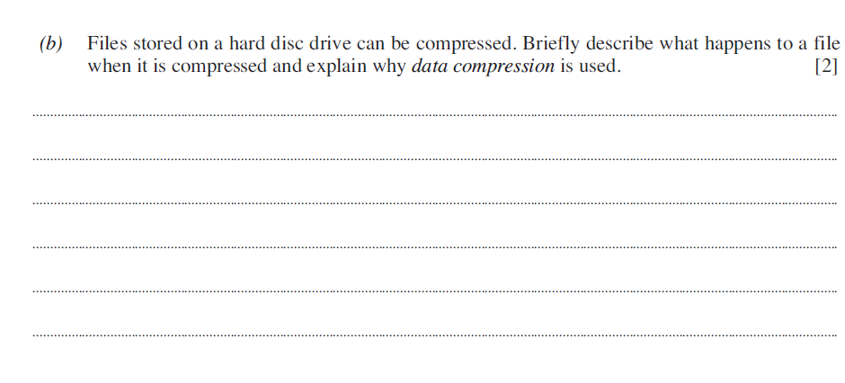
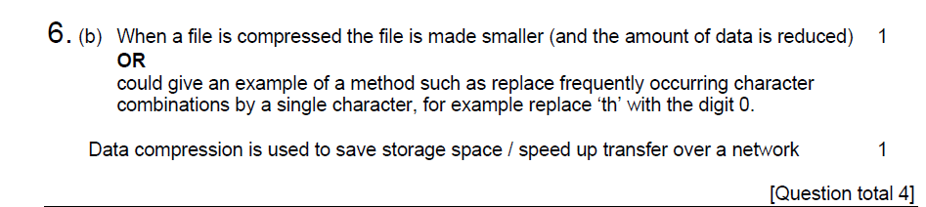
Example assessment …

Slide 14
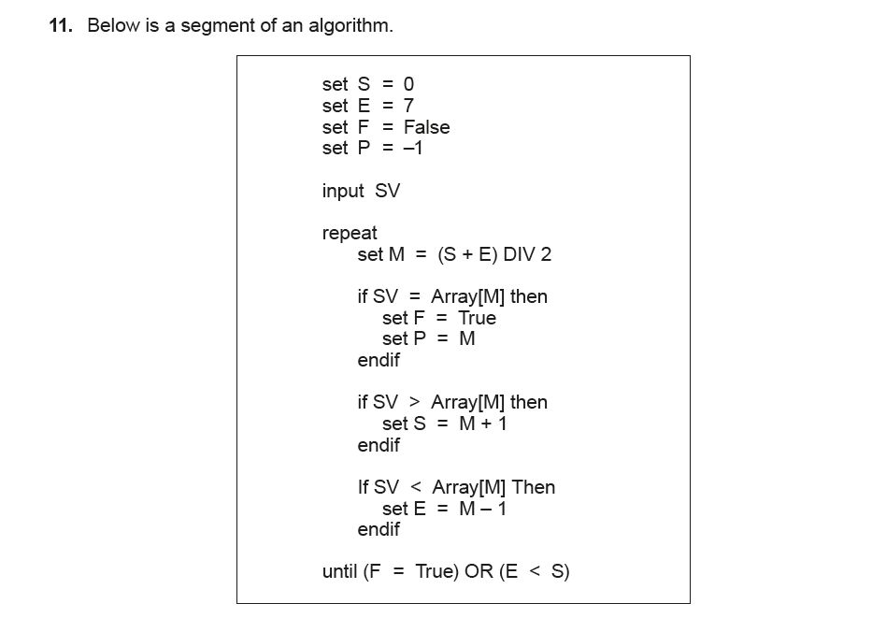
Example assessment …

Slide 15
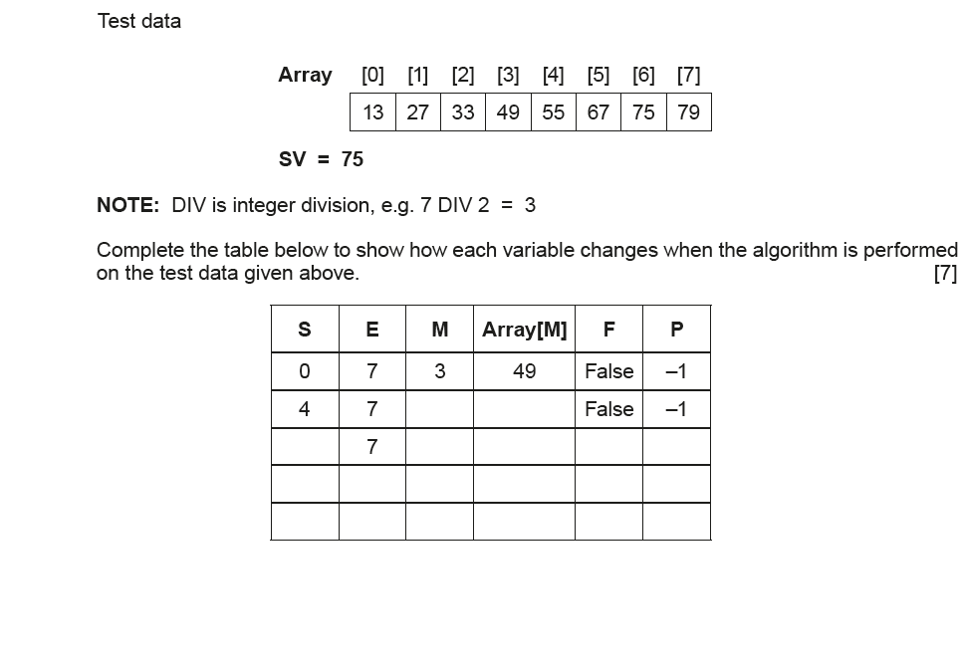
Example assessment …

